Slide 1
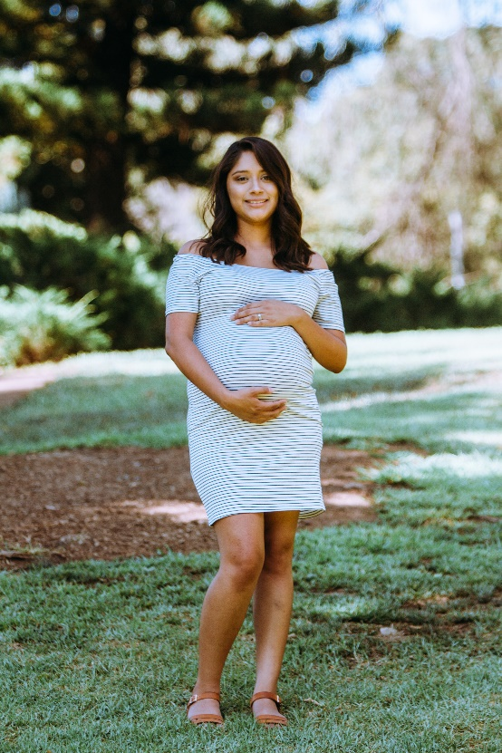
BABY BOTTLE CAMPAIGN
Our Baby Bottle campaign started last week!
Join with us in support of those in our community
facing unplanned pregnancies!
You can fill your bottle with coins, cash, or a
check payable to Options Pregnancy Clinic.

