Slide 1
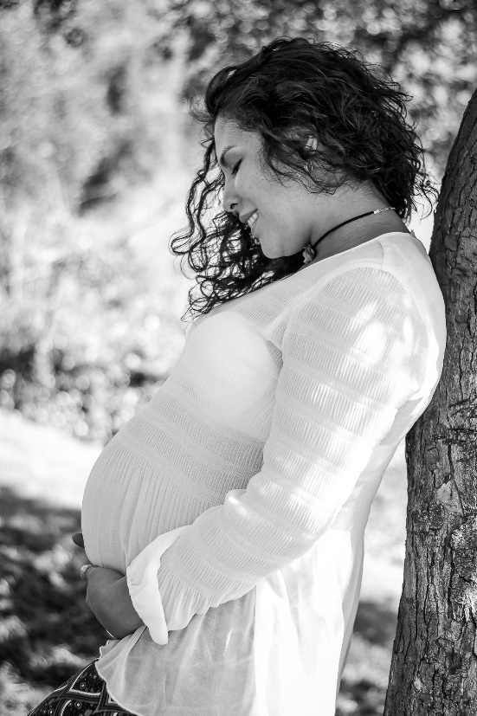
BABY BOTTLE CAMPAIGN
Just 2 more weeks left to
fill your baby bottle!
Join with us in support of those in our community
facing unplanned pregnancies!
** You are making a difference!**
You can fill your bottle with coins, cash or a check payable Options Pregnancy Clinic.

