Slide 1
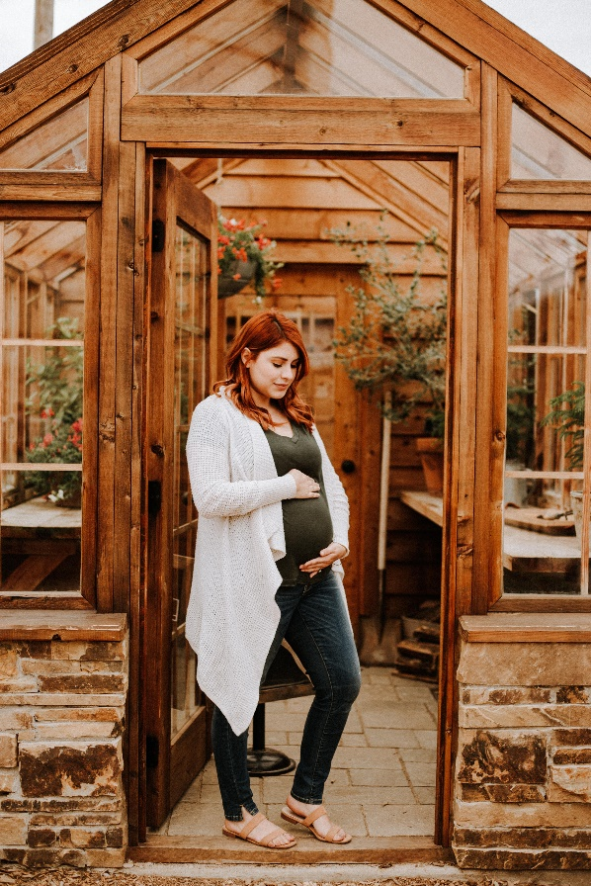
BABY BOTTLE CAMPAIGN
Our Baby Bottle Campaign Is Starting Today!
Join with us in support of those in our community
facing unplanned pregnancies!
1. Bring a baby bottle home from church today.
2. Fill it with spare change, cash or a check.
3. Return your bottle (full, partially filled, or empty)
to church when the campaign ends.

