Slide 1
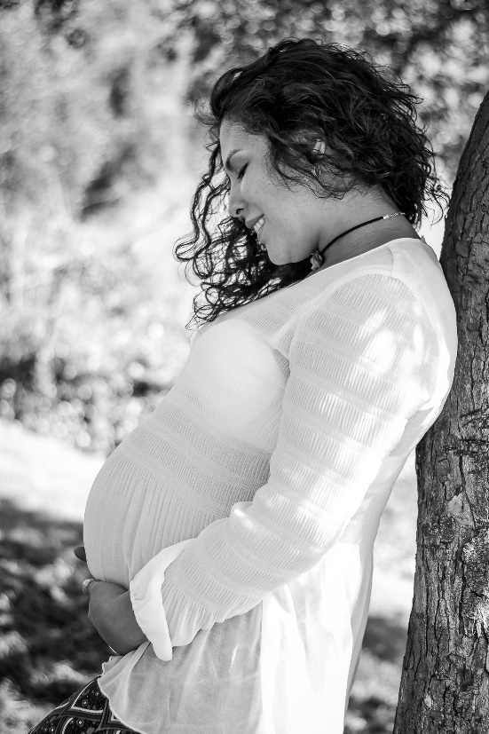
BABY BOTTLE CAMPAIGN
Just one week left to fill your
baby bottle!
Join with us in support of those in our community
facing unplanned pregnancies!
** Bring your bottle next week**
You can fill your bottle with coins, cash or a check payable Options Pregnancy Clinic.

