Slide 1
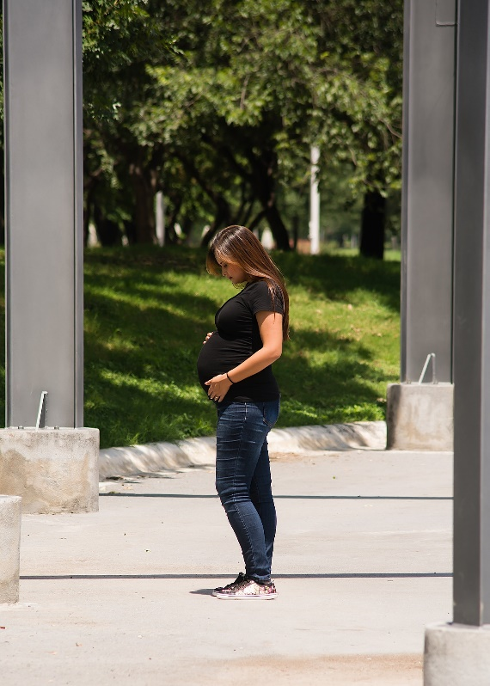
BABY BOTTLE
CAMPAIGN
The Baby Bottle campaign ends TODAY!
Please return your bottle to the coordinator before you leave.
It’s not too late if you forgot it today. Bring it next week.
Empty bottle? That’s OK! Please return any empty, partially-filled, or full bottles.

